Slide 1
Sport Charities Board & Trustee Duties
HCR Law in partnership with LawInSport

Slide 2

Presented by:
Joe Hobbins
Solicitor
Charities and Not-for-Profit
T: 01604 463 157
M: 07909262049
E: JHobbins@hcrlaw.com

Slide 3
Overview of the session
What it means to be a charity trustee
The core duties of a trustee
The role of the Charity Commission
Useful materials for maximising effectiveness and compliance

Slide 4
Charity Trustee
Trustee = the persons having the general control and management of the administration of a charity.
Charity = an institution which:
is established for charitable purposes only; and
is subject to the control of the High Court’s charity law jurisdiction.
Most Commonly:
Charitable Incorporated Organisation;
Charitable Company;
Unincorporated Associations; and
Trusts

Slide 5
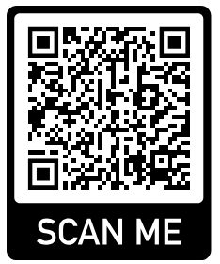
Core Duties of a Trustee - CC3
Ensure your trustees are eligible and your charity is carrying out its purposes for the public benefit
01
Comply with your governing document, and the law.
02
Act in your charity’s best interests
03
Manage your charity’s resources responsibly
04
Act with reasonable care and skill
05
Ensure your charity is accountable
06

Slide 6
Eligibility of trustees and public benefit
Duty 1 – Ensure your trustees are eligible and your charity is carrying out its purposes for the public
Familiarise yourself with the legal requirements of being a trustee, and the provisions in your governing document.
Ensure your charity is carrying out the purposes for which it was set up:
Plan what your charity will do, and what you want it to achieve.
Be able to explain how all the charity’s activities are intended to further or support its purposes.
Understand how the charity benefits the public by carrying out its purposes.

Slide 7
The Governing Document
Charity’s purposes or ‘objects’
Powers and restrictions
Who runs it and how they do so – e.g. meetings and quorum
How Trustees are appointed/removed
Rules
Powers of delegation and execution of documents
Closure of the charity (Dissolution)
Duty 2 – Comply with your governing document and the law
The Law
Charities Acts
Safeguarding regulations
Data protection
Tax and accounting (more on SORP below)

Slide 8
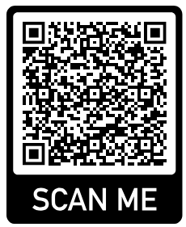
Understanding the best interests of the charity
Duty 3 – Act in your charity’s best interests
Trustees have a wide discretion to decide how a charity’s interests will best be served.
This is NOT about serving the best interests of trustees / staff / members / funders or ensuring longevity at all costs.
Decision making must follow best practice
Collective responsibility – not the same as unanimity
Deal with conflicts of interest and/or loyalty
Know the rules on trustees’ benefits

Slide 9
Trustees must act responsibly, reasonably and honestly
Duty 4 – Manage your charity’s resources responsibly
Protect the charity’s assets – be compliant and not expose your charity to unmanaged / unreasonable risk – including investments
Ensure your policies are relevant, in line with best practice and regularly reviewed
Understand what risk management means and how it applies to your charity
Take steps to understand your charity’s finances and budgeting
Review the relationship with any trading subsidiary

Slide 10
The duty of care
Duty 5 – Act with reasonable care and skill
Two broad parts to this duty.
Trustees must:
Use reasonable care and skill, making use of their particular skills and experience, and taking advice when necessary
Give enough time, thought and energy to the role, for example by preparing for, attending and actively participating in all trustees’ meetings
and know what to do when something goes wrong…

Slide 11

Enhanced Duty of Care
If a trustee has, or holds themselves out as having, special knowledge or experience, they have an enhanced duty to use this knowledge or experience for the benefit of the charity
For example, a trustee with Safeguarding expertise!
Key Duties of a Trustee

Slide 12
Comply with statutory accounting and reporting requirements
Duty 6 – Ensure your charity is accountable
Be able to demonstrate that your charity is:
Complying with the law
Well-run
Effective
All charitable companies must prepare their accounts and trustees’ annual report in accordance with the Charities SORP
Failure to submit accounts to the Commission is a criminal offence and is regarded by them as mismanagement and/or misconduct
Accountability extends to all those stakeholders with an interest in the charity.
Use your powers of delegation effectively to manage the range of responsibilities; communicate well

Slide 13





The Role of the Charity Commission
Registrar
Regulator
Guidance
Sanctions –
Enforcement & Intervention
Serious incident reporting

Slide 14
The Charity Commission – Regulator
Regulates all charities, of which there are 171,057 registered (September 2025)
Aims to ensure charity trustees comply with their legal duties and addresses any failures
Proactively and reactively monitors charities which give rise to regulatory concerns
Investigates specific issues or monitors a charity’s activities
Can open a statutory inquiry into a charity where there are serious concerns

Slide 15

The Charity Commission – Sanctions
Enforcement and Intervention
CC’s priority is to ensure trustees meet their legal requirements and obligations
Where there has been abuse or non-compliance in charities, the Commission may require corrective action to be taken by the trustees and undertake checks to ensure the action has been taken.
CC can take enforcement action when there is malpractice or misconduct
CC’s powers include (amongst others):
Restricting the transactions that a charity may enter into
Appointing additional trustees
‘Freezing’ a charity’s bank account
Suspending or removing a trustee
Appointing an interim manager

Slide 16
The Charity Commission – Governance
The Charity Commission urges compliance with:
Charity Governance Code
Charity Commission diagnostic tool
All relevant Charity Commission guidance
…as well as all applicable laws
The Charity Governance Code states that good governance is fundamental to a charity’s success because:
It enables and supports the charity’s compliance with the law
It promotes a culture in which everything works towards fulfilling the charity’s vision

Slide 17
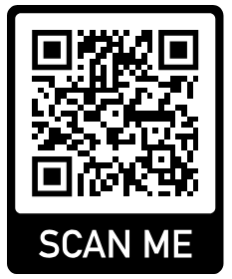
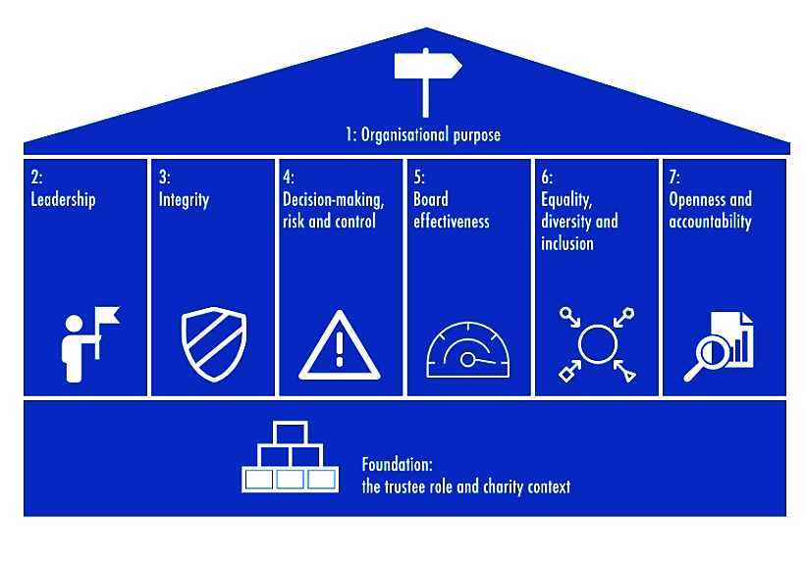
Charity Governance Code
“Good governance in charities is fundamental to their success”
There are seven Code principles which help build upon trustees’ basic legal knowledge and regulatory requirements.
Organisational purpose
Leadership
Integrity
Decision-making, risk and control
Board effectiveness
Equality, diversity and inclusion
Openness and accountability

Slide 18
Charity Governance Code – Principles
Organisational purpose
the trustees should be clear about the charity’s aims and ensure these are delivered effectively and sustainably.
Leadership
strong leadership allows the charity to adopt an appropriate strategy for delivering its aims and values.
Integrity
by adopting values, applying ethical principles to decisions, and creating a supportive culture, a charity acts with integrity which helps it to achieve its purposes.
Decision-making, risk and control
all decisions taken by the trustees should be informed, rigorous and timely. There should be management systems in place which are carefully monitored to ensure the trustees oversee all delegated matters.
Board effectiveness
the trustees should work as an effective team, balancing their skills, experience, background, and knowledge to make informed decisions.
Equality, diversity and inclusion
it is important to have a clear, agreed and effective approach to support these issues.
Openness and accountability
the trustees should lead in being transparent and accountable which will increase the public’s trust in charities

Slide 19
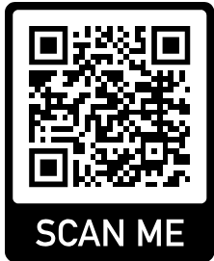
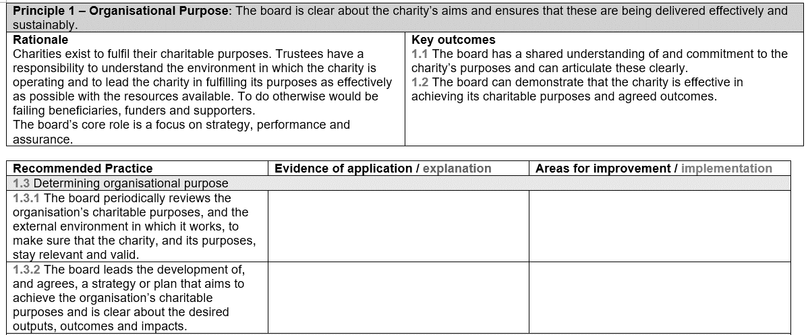
Charity Governance Code – Diagnostic Tool
Provides a table to enable trustees to assess whether they are complying with recommended best practice – laid out as follows:

Slide 20

The Charity Commission – Guidance
Guidance to charities to help them run as effectively as possible
5-minute guides for charity trustees
Link to CC guidance:

Slide 21
Any questions?

